Slide 1
Category review: Chips
June 2020
Retail Analytics
Brand note: If client logo is not required, use alternate title page layout right click slide thumbnail > Layout > Title

Slide 2
Executive summary
Kettle was the highest performing chip brand.
Family and other customer segments contributed the largest share of sales
Mainstream customers generated the highest overall revenue.
Larger pack sizes were popular among family households
01
Task 1
Trial stores showed improved performance during the trail period.
Sales uplift was observed when compared with selected control stores.
Increased customer participation was a key driver of growth.
02
Task 2

Slide 3
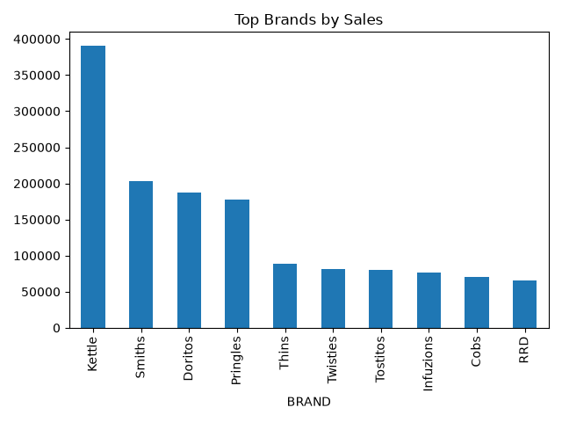
Category Behaviour
Customer Purchasing Behaviour
Kettle dominated category sales
Smiths ,Doritos and Pringles were strong secondary brands.
Family oriented customer segments purchased more frequently.

Slide 4
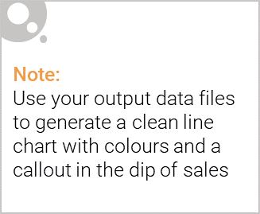
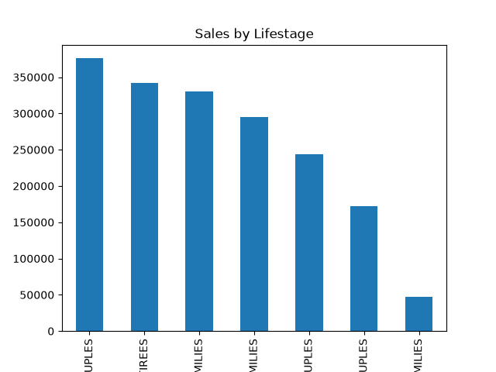
Affluence and Life Stage Analysis
Older Familes and Young Families generated significant sales.
Mainstream customers represented the largest customer group.
Premium customers spent more per shopping ocassion.
Budget customers remained important due to volume.

Slide 5

Trial Store Performance
Control Store Selection:
Trial stores:
Store 77
Store 86
Store 88
Control stores selected using:
Sales correlation
Customer similarity
Transaction similarity

Slide 6
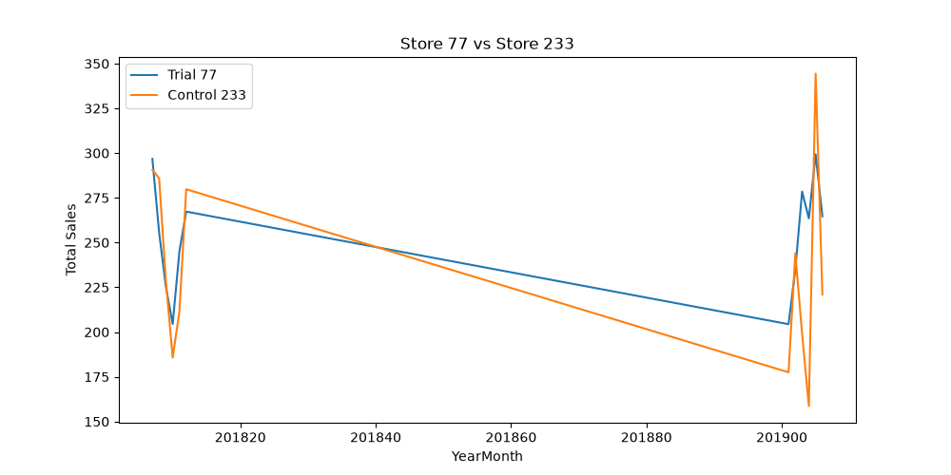
Trial Results
Store 77
positive sales uplift observed
Higher customer engagement

Slide 7
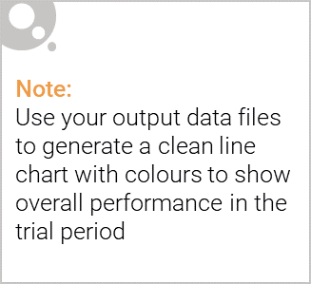
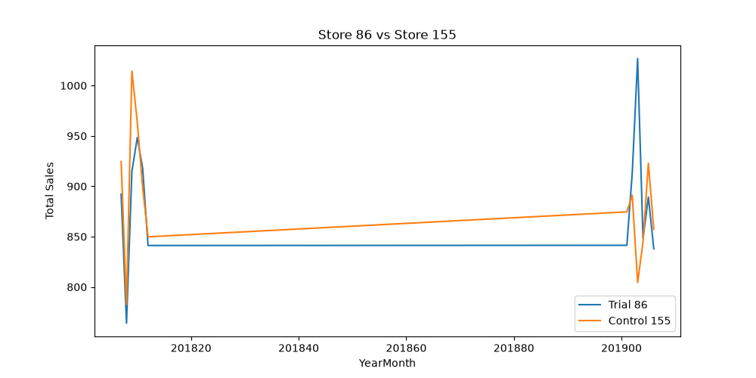
Store 86
Moderate improvement
Smaller impact than store 77.

Slide 8
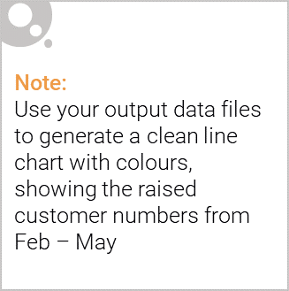
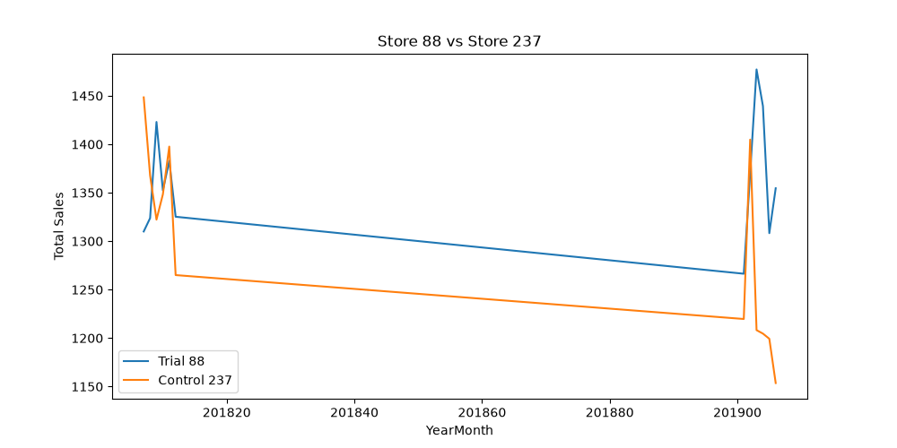
Store 88
Strong sales growth during trial period.
Trial considered successful.

Slide 9
Recommendations
Strategic recommendations
Roll out successful trial initiatives to similar stores.
Focus marketing investment on high performing brands.
Continue targeting family based customer segments.
Monitor sales and customer behaviour post rollout.
Use trial methodology for future category testing.

